Slide 1
Working with Amazon’s Alexa Skills Kit
Notes:
Talking Points:

Slide 2
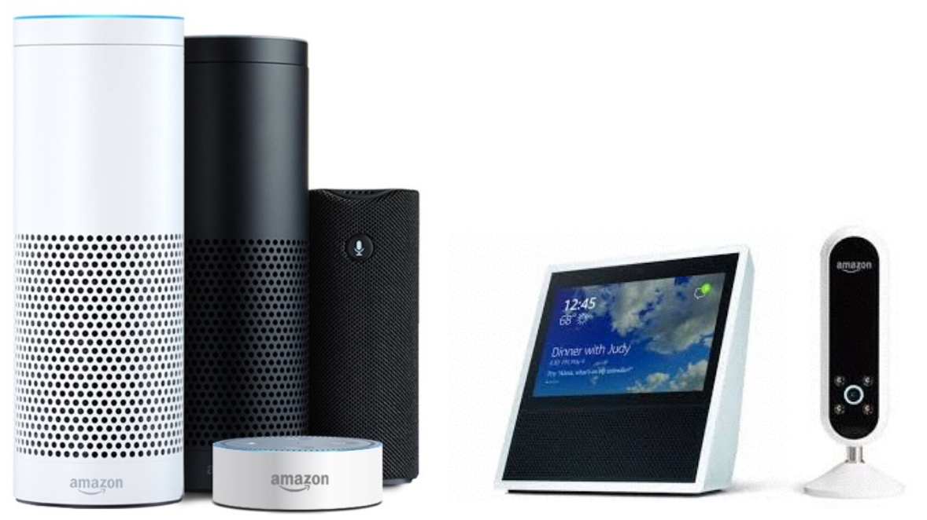
Available Amazon Devices

Slide 3
How the world views Alexa and our subscribers
Saturday Night Live did a faux commercial for Alexa Silver, an Alexa designed for “the greatest generation”:
http://www.nbc.com/saturday-night-live/video/amazon-echo/3518896?snl=1
Amazon Alexa VP Toni Reid agreed that the SNL spoof is “actually spot on”
https://www.geekwire.com/2017/amazon-alexa-chief-saturday-night-live-spoof-echo-speaker-actually-kind-spot/

Slide 4
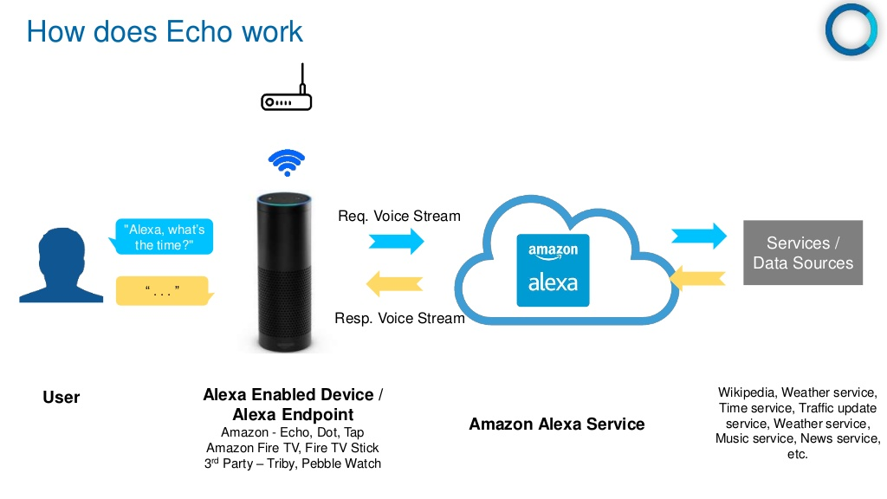

Slide 5
Definition of Terms
Wake Word: The word used to start an interaction with an Amazon device. Current wake words are: Alexa, Echo, Amazon, and Computer.
Invocation Name: The two or more word name that a user will use to start a dialog.
Skill: The application that responds to an invocation
Intent: The action or request that a user can interact with.
Utterance: The words that a user will use to invoke an intent
Slot: Custom values used in intents.

Slide 6
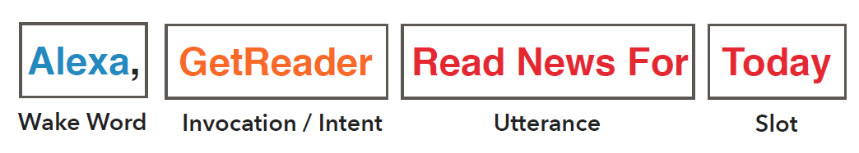
Putting the terms together as a skill

Slide 7
Tools to use
Blueprints:
https://blueprints.amazon.com/
Alexa Developer Console:
https://developer.amazon.com/edw/home.html#/
Amazon Web Services (AWS):
https://console.aws.amazon.com/console/home
Lambda service – Hosts services
CloudWatch – Logs
Skill Code Generator:
https://s3.amazonaws.com/knight-sunglasses/index.html
Skill Testing Tool:
https://echosim.io/welcome
Storyline Tool:
https://getstoryline.com/

